Slide 1
Account lookup
Technical - Overview
Integration Team
2018

Slide 2
AGENDA
Overview
Flows
Rules
Structure Types, Logical Fields
Bulk Vs Single mode
Fees in Account Lookup

Slide 3
“
Account lookup is performed in GPP to retrieve account and customer information required for successful processing. ”

Slide 4
SEND REQUEST flow
Wait Behaviour Wait CDB (CDBWAIT queue)
Debit CDB
Account Lookup
Credit CDB
Internet Banking, Branch-OTC, SWIFT, Local Clearing
Receive Payment Instruction
Payment Initiation
Debit Side Processing
Credit Side Processing
Once the Account Lookup interface is invoked, and if the interface is working in A-sync mode, the message processing is stopped and the message waits for the response in the queue (status) of Wait CDB response (CDBWAIT).
Compliance
FX Engine
SWIFT, Local Clearing
Payment execution
Fees Processing
MOP Selection Value Date and Cut Offs
Available at every complete or intermediate status
Accounting System
Balance Inquiry
Advising System

Slide 5

Successful response Flow
Wait Behaviour Wait CDB (CDBWAIT queue)
Debit response
Account Lookup
Credit response
Debit with Fees response
Internet Banking, Branch-OTC, SWIFT, Local Clearing
Receive Payment Instruction
Payment Initiation
Debit Side Processing
Credit Side Processing
Compliance
If positive response with no posting restrictions, GPP stores the account information and the message continues the processing to the next step.
FX Engine
SWIFT, Local Clearing
Payment execution
Fees Processing
MOP Selection Value Date and Cut Offs
Available at every complete or intermediate status
Accounting System
Balance Inquiry
Advising System

Slide 6

Failure response Flow
Wait Behaviour Wait CDB (CDBWAIT queue)
CDB POSTRES Failure
Account Lookup
CDB Technical Failure
Internet Banking, Branch-OTC, SWIFT, Local Clearing
Receive Payment Instruction
Payment Initiation
Debit Side Processing
Credit Side Processing
Compliance
If a response with posting restrictions, the message is routed to the Posting Restriction (POSTREST) queue, for manual override or retry.
If negative response, either technical or functional, the message is routed to the REPAIR queue, for manual handling.
Technical errors
Request not valid
Host system not available
Functional errors:
Account not found
Account currency does not match
FX Engine
SWIFT, Local Clearing
Payment execution
Fees Processing
MOP Selection Value Date and Cut Offs
Available at every complete or intermediate status
Accounting System
Balance Inquiry
Advising System

Slide 7



Account lookup rules
Rules should be set up in order to invoke the Account Lookup interface for the debit or credit account in cases they belong to a customer (relevant side MOP is BOOK), and as per specific FI business scenarios and conditions.
These rules are invoked whenever a debit or credit account of a message is not found in GPP, or is found but the Check CDB check box is selected, indicating that the master copy for this account resides in the FI’s external system.

Slide 8
Single mode
Account Lookup
Internet Banking, Branch-OTC, SWIFT, Local Clearing
Receive Payment Instruction
Payment Initiation
Debit Side Processing
Credit Side Processing
GPP invokes the Account Lookup interface for the following accounts:
Credit: Invoked for the credit account only
Debit: Invoked for the debit account only
Both: Invoked for both the credit and debit accounts for an On-Us transaction.
Compliance
FX Engine
SWIFT, Local Clearing
Payment execution
Fees Processing
MOP Selection Value Date and Cut Offs
Available at every complete or intermediate status
Accounting System
Balance Inquiry
Advising System

Slide 9
BULK mode
For Source side GPP SP is working in Sync mode, which is single interface.
On the source side, where an account in the PmntInf level is the same for all the transactions in same level, GPP invokes the interface for the first transaction only and stores the received information in the system cache. For all subsequent transactions in the level, GPP retrieves the account information from the cache.

Slide 10
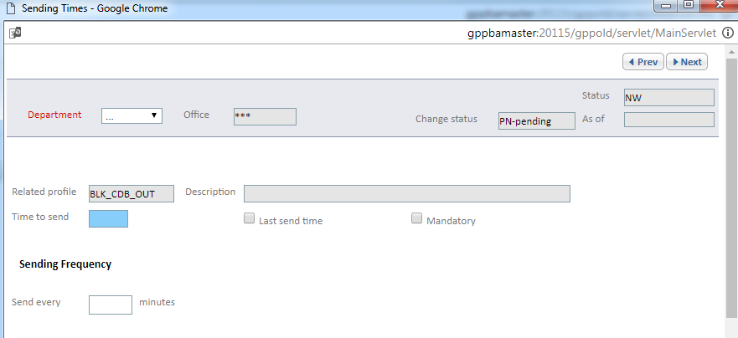
Single Vs bulk mode
When processing a transaction file, GPP invokes the interface for each transaction in the file.
GPP executes the target-side Account Lookup interface in asynchronous mode (because of the large number of customer accounts in the GPP database) and improves performance by not implementing timeout and retry functionality for the interface. The generation of file request is triggered by sending time mechanism .

Slide 11
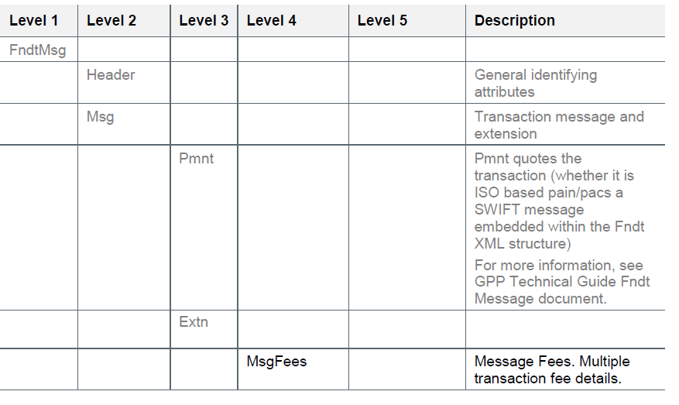
FEES in Account lookup response
When the financial institution system reports fees to be charged for the specific account/customer, and it is required that GPP will include these feed in the posting for the applicable transaction, <MsgFees> section needs to be included in the response.

Slide 12
Response return codes
When using the Standard Fndt Message, the FI can also directly use the GPP internal numeric return codes as follows:
1 – to indicate a Success
990 – to indicate a Processing/technical error
996 – to indicate a Posting restriction
0 – to indicate any error when no specific error handling is required but routing transaction to Repair
Note: Although the interface supports receiving proprietary return codes for the various failure responses, as long as the appropriate mapping between financial institution’s codes and GPP internal codes is pre-configured.

Slide 13
Thank you
Integration Team
aviad.pilo@finastra.com

